Slide 1
TVET's NSC Results, Placement Asessment, WIL : Status Feedback
Presenter: Linda Putu

Slide 2
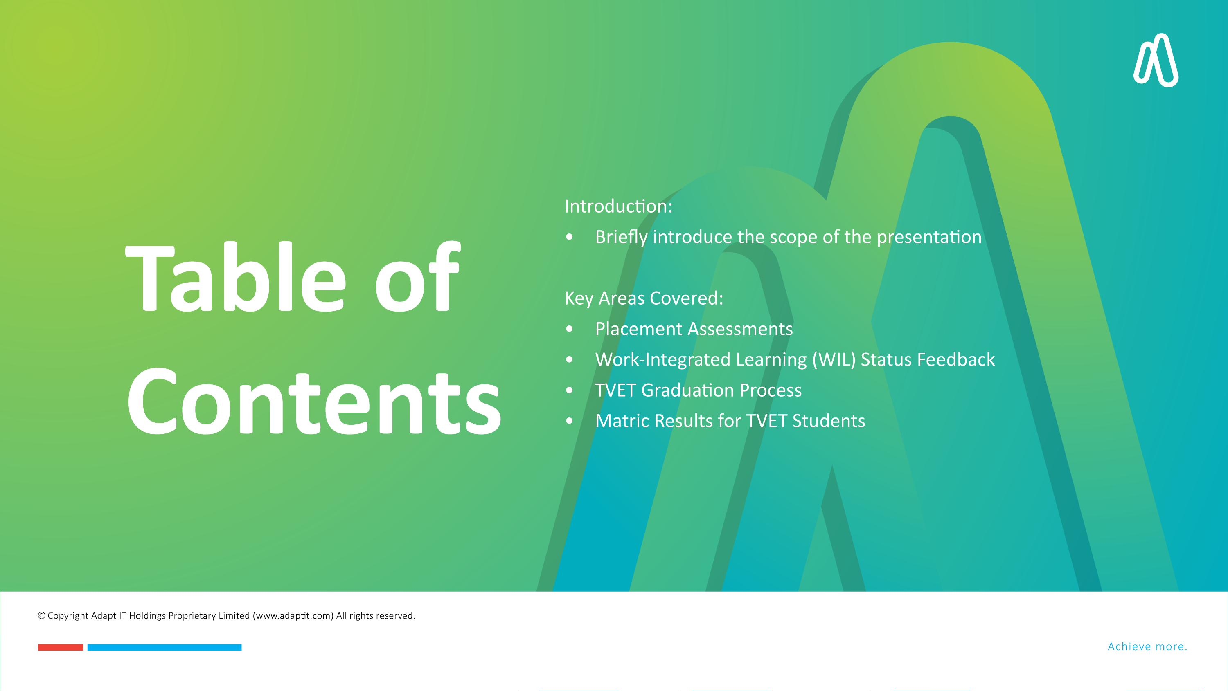
Introduction: Briefly introduce the scope of the presentation
Key Areas Covered:
Placement Assessments
Work-Integrated Learning (WIL) Status Feedback
TVET Graduation Process
Matric Results for TVET Students

Slide 3

Placement Assessments

Slide 4

Placement Assessments - API Integration
What is the API for SREGB-5?
  The API will enable automatic data capture for placement assessments into the SREGB-5 form (or system). This API integration aims to streamline the entire process of collecting, storing, and retrieving placement test results, reducing manual entry and ensuring that all information is captured accurately and promptly.
API Overview:
  The API will facilitate seamless data exchange between placement assessments and the ITS system. The key functionality of this integration is that it will automatically push placement test results into the system, eliminating the need for duplicate data entry.

Slide 5

Placement Assessments - API Integration
Workflow Overview
Outline of the proposed workflow for placement assessments
Step 1: Creation of applicant data on SREGB-5.
Step 2: Capture of placement test results.
Step 3: Email notifications to students and administrators.
Step 4: Report generation for result tracking.

Slide 6

Placement Assessments - API Integration
Benefits
Streamlined Data Entry: No more manual entry or risk of errors when transferring test results into the system.
Improved Data Accuracy: Automation ensures that test results are captured correctly, with reduced human error.
Real-Time Data Availability: Placement assessment results will be immediately available for processing, reporting, and communication.
Faster Process Time: By reducing manual intervention, the overall process of student placement becomes faster, helping to reduce administrative workload.

Slide 7

Next Steps/Action Items:
Finalize API Integration:
The development team will continue to build out and test the API to ensure smooth integration with the SREGB-5 system.
Testing and Validation:
Once the API is integrated, we'll test it with real placement test data to ensure that the results are accurately captured and reported in the system.
Notes:
How can we ensure the API works seamlessly across different platforms and systems used by various institutions?
Should we implement any additional notifications or confirmation alerts when the API successfully captures the data? (e.g., email confirmation to both student and admin)
Are there any edge cases or possible exceptions we should account for in the data capture process?

Slide 8

Work-Integrated Learning (WIL) - System Enhancements

Slide 9

Overview of WIL Enhancements:
Overview of WIL Enhancements:
The WIL module has undergone significant improvements to streamline the tracking, feedback, and reporting processes for students and administrators. These enhancements aim to:
Provide real-time updates on WIL status.
Improve communication between students, employers, and institutions.
Enhance the user interface (UI) for better accessibility and ease of use.

Slide 10

Key Improvements
User-Friendly Interface:
Updated screens make navigation easier for both students and administrators.
Responsive design ensures compatibility across devices (mobile, tablet, desktop).
Real-Time Status Feedback:
Students can track the progress of their WIL placements (application, approval, completion stages).
Administrators can monitor the WIL process and provide feedback instantly.
Automated Notifications:
Email and system notifications inform students about changes in their WIL status.
Employers and mentors can easily provide evaluations via the system.
Reporting and Analytics:
New reports allow institutions to track placement success rates, monitor employer feedback, and assess student performance.

Slide 11

TVET Graduator Process

Slide 12

TVET Graduation Process: N6 Qualification Automation
Overview:
Introduce the new automated process for awarding the N6 qualification.
Process Flow:
Qualification Validation: Automatic checks for required criteria (subjects, grades).
Service Request: Triggered once qualifications are validated.
POE Document Approval: Workflow to ensure proper document submission and approval.
Final Graduation Update: Once the POE is approved, graduation results are finalized.
Benefits:
Automation reduces manual intervention.
Increased accuracy and faster processing.
Clear status tracking at each stage.

Slide 13

TVET Graduation Process: POE Document Approval & Cleanup
POE Approval:
Steps taken to ensure POE documents are approved by the department.
Automated updates to student records upon approval.
Batch Cleanup:
If the POE is not approved, a cleanup process will automatically cancel pending service requests based on predefined end dates.
This ensures that no incomplete graduation processes are left open.

Slide 14

Matric Results for TVET Students

Slide 15
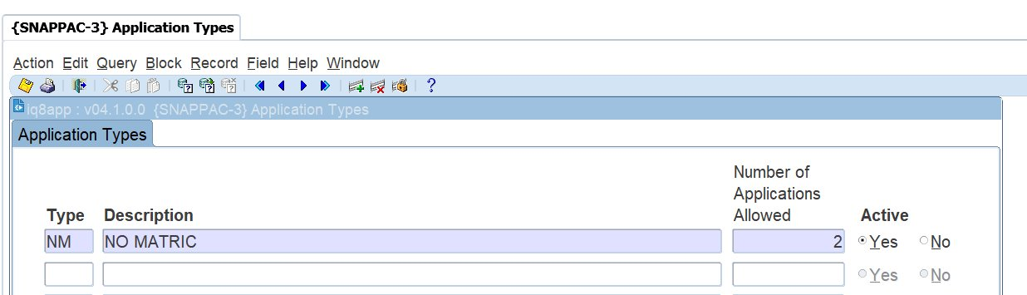
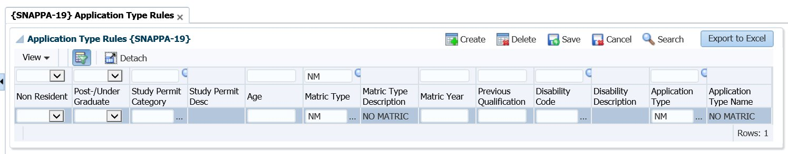
Handling Applications from Prospective Students Without Matriculation
Create Application Types:
Set up different application types (e.g., NM) in the system.
Link each application type to the relevant school leaving or matriculation types defined in the client’s environment.
Connect to Cycles and Qualifications:
Associate the created application types with the correct application cycles and entry-level qualifications.

Slide 16

Key Takeaways

Slide 17
Key Takeaways
Placement Assessments: API integration and improved workflow for capturing placement test data.
01
WIL: Enhanced system and user experience, with real-time feedback.
02
TVET Graduation Process: Automated qualification awarding for N6 and efficient document approval process.
03
Matric Results: Improved application process for non-matriculating students.
04

